Slide 1
















Normalization of Database

Slide 2
Objectives of Lecture
Understand what normalization is and what role it plays in database design
Learn about the normal forms 1NF, 2NF, 3NF, BCNF, and 4NF
Identify how normal forms can be transformed from lower normal forms to higher normal forms
Understand normalization and E-R modeling are used concurrently to produce a good database design
Understand some situations require denormalization to generate information efficiently

Slide 3
Why Normalization?
To produce well-structured relations
Any relational database should contain minimal data redundancy and allows users to insert, delete, and update rows without causing data inconsistencies (anomalies)
Goal of Normalization: producing well-structured relations by eliminating anomalies

Slide 4
Type of Anomalies
Update (Modification) Anomaly
Changing data in a row forces changes to other rows because of duplication
Deletion Anomaly
Deleting rows may cause a loss of data that would be needed for other future rows
Insertion Anomaly
Adding new rows forces user to create duplicate data

Slide 5
Each Anomaly Examples
Consider the following table that stores data about auto parts and suppliers. This seemingly harmless table contains potential problems.
Part# | Description | Supplier | Address | City | State
100 | Coil | Dynar | 45 Eastern Ave. | Denver | CO
101 | Muffler | GlassCo | 1638 S. Front | Seattle | WA
102 | Wheel Cover | A1 Auto | 7441 E. 4th Street | Detroit | MI
103 | Battery | Dynar | 45 Eastern Ave. | Denver | CO
104 | Radiator | United Parts | 346 Taylor Drive | Austin | TX
105 | Manifold | GlassCo | 1638 S. Front | Seattle | WA
106 | Converter | GlassCo | 1638 S. Front | Seattle | WA
Suppose, we need to add another part. 107 Tail Pipe GlassCo 1638 S. Front Seattle WA

Slide 6
Update Anomaly
What if GlassCo moves to Olympia? How many rows have to be changed in order to ensure that the new address is recorded – Address and City
Part# | Description | Supplier | Address | City | State
100 | Coil | Dynar | 45 Eastern Ave. | Denver | CO
101 | Muffler | GlassCo | 1638 S. Front | Seattle | WA
102 | Wheel Cover | A1 Auto | 7441 E. 4th Street | Detroit | MI
103 | Battery | Dynar | 45 Eastern Ave. | Denver | CO
104 | Radiator | United Parts | 346 Taylor Drive | Austin | TX
105 | Manifold | GlassCo | 1638 S. Front | Seattle | WA
106 | Converter | GlassCo | 1638 S. Front | Seattle | WA
107 | Tail Pipe | GlassCo | 1638 S. Front | Seattle | WA

Slide 7
Deletion Anomaly
Suppose you no longer carries part number 102 and decide to delete that row from the table?
Part# | Description | Supplier | Address | City | State
100 | Coil | Dynar | 45 Eastern Ave. | Denver | CO
101 | Muffler | GlassCo | 1638 S. Front | Seattle | WA
102 | Wheel Cover | A1 Auto | 7441 E. 4th Street | Detroit | MI
103 | Battery | Dynar | 45 Eastern Ave. | Denver | CO
104 | Radiator | United Parts | 346 Taylor Drive | Austin | TX
105 | Manifold | GlassCo | 1638 S. Front | Seattle | WA
106 | Converter | GlassCo | 1638 S. Front | Seattle | WA
107 | Tail Pipe | GlassCo | 1638 S. Front | Seattle | WA

Slide 8
Now, looking at the remaining data below, what is the address of A1 Auto? - supplier (A1 Auto) address must be deleted as well
Part# | Description | Supplier | Address | City | State
100 | Coil | Dynar | 45 Eastern Ave. | Denver | CO
101 | Muffler | GlassCo | 1638 S. Front | Seattle | WA
103 | Battery | Dynar | 45 Eastern Ave. | Denver | CO
104 | Radiator | United Parts | 346 Taylor Drive | Austin | TX
105 | Manifold | GlassCo | 1638 S. Front | Seattle | WA
106 | Converter | GlassCo | 1638 S. Front | Seattle | WA
107 | Tail Pipe | GlassCo | 1638 S. Front | Seattle | WA

Slide 9
Insertion Anomaly
Next, you want to add a new supplier – “CarParts.” But you have not yet ordered parts from that supplier – No PK and description
Part# | Description | Supplier | Address | City | State
100 | Coil | Dynar | 45 Eastern Ave. | Denver | CO
101 | Muffler | GlassCo | 1638 S. Front | Seattle | WA
103 | Battery | Dynar | 45 Eastern Ave. | Denver | CO
104 | Radiator | United Parts | 346 Taylor Drive | Austin | TX
105 | Manifold | GlassCo | 1638 S. Front | Seattle | WA
106 | Converter | GlassCo | 1638 S. Front | Seattle | WA
107 | Tail Pipe | GlassCo | 1638 S. Front | Seattle | WA
???? | ???????? | CarParts | 101 Mariposa | Orlando | FL

Slide 10
Utilizing Functional Dependency Theory
As a solution for taking care of Anomalies
Normalization is based on functional dependencies
Functional Dependency: The value of one attribute determines the value of another attribute
Notation: (arrow)
A → B when value of A (of a valid instance) defines the value of B (B is functionally dependent upon A)
SSN defines Name, Address (not vice versa)
A is the determinant in a functional dependency

Slide 11
Example of Functional Dependency
SSN -> Name, Birth-date, Address
VIN -> Make, Model, Color
ISBN -> Title, Author
Not acceptable dependencies
Partial dependency
Transitive dependency
Hidden dependency

Slide 12
First Normal Form (1NF)
To be in First Normal Form (1NF),
Each column must contain only a single value
Repeating groups of records (redundancy) must be eliminated
Eliminate duplicative columns from the same table
There must not be a composite and a multi-valued attributes
Transformation from model to relation

Slide 13
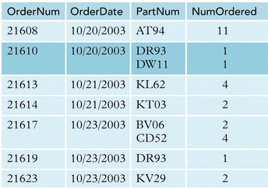
1NF Example-1
Unnormalized Table
PK

Slide 14
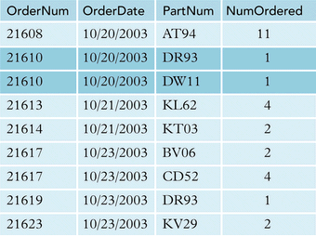
Con’t…
Conversion to 1NF
PK

Slide 15
1NF Example-2
PK
Cust_ID | L_Name | F_Name | Address
104 | Suchecki | Ray | 123 Pond Hill Road, Detroit, MI, 48161
PK
Cust_ID | SalesRep_Name | Rep_Office | Order_1 | Order_2 | Order_3
1022 | Jones | 412 | 10 | 14 | 19

Slide 16
Second Normal Form
In order to be in 2NF, a relation must be in 1NF and a relation must not have any partial dependencies
Any attributes must not be dependent on a portion of primary key
The other way to understand 2NF is that each non-key attribute (not a part of PK) in the relation must be functionally dependent upon the primary key

Slide 17
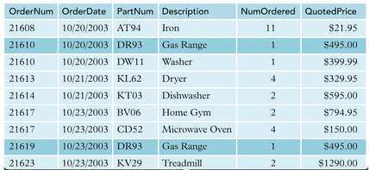
2NF Example
PK
PK
Each arrow shows partial dependency
OrderNum, PartNum → NumOrdered, QuotedPrice
OrderNum → OrderDate / PartNum → Description

Slide 18
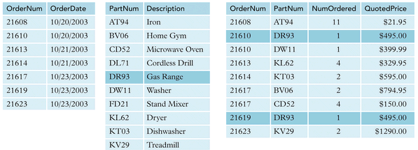
2NF Example
PK
PK
PK
PK

Slide 19
Third Normal Form
In order to be in Third Normal Form, a relation must first fulfill the requirements to be in 2NF
Additionally, all attributes that are not dependent upon the primary key must be eliminated. In other words, there should be no transitive dependencies
remove columns that are not dependent upon the primary key

Slide 20
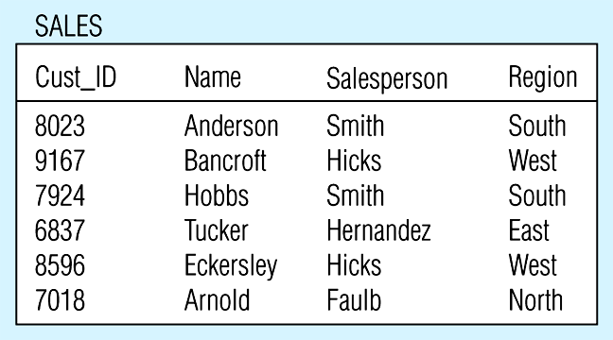
Example of 3NF
PK

Slide 21
Transitive Dependency
All attributes are functionally dependent on Cust_ID
Cust_ID → Name, Salesperson
However, there is a transitive dependency
Region is functionally dependent on Salesperson but Salesperson is not a “Determinants”
Salesperson → Region

Slide 22
What kind of anomaly will happen if the company needs to add a new salesperson (John Doe) to the North region right away?
What kind of anomaly will happen tomorrow if the company deletes the customer number 6837 from the table today?
What kind of anomaly will happen if Smith (salesperson) must be reassigned to the East region right away?

Slide 23
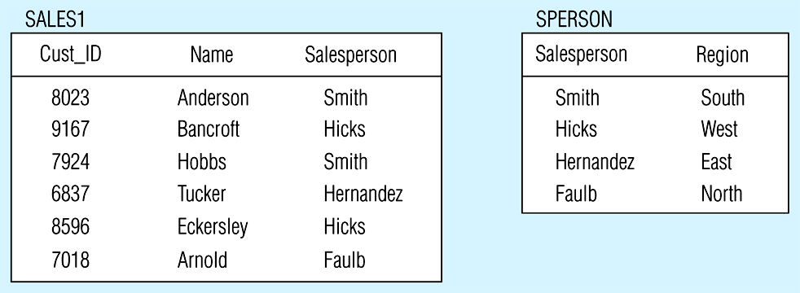
Decomposing the SALES relation
FK
PK
PK

Slide 24
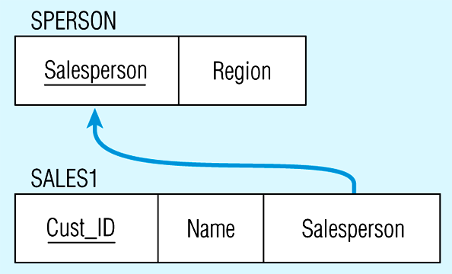
Relations in 3NF
Salesperson → Region
CustID → Name and CustID → Salesperson
Now, there are no transitive dependencies
Both relations are in 3rd NF

Slide 25
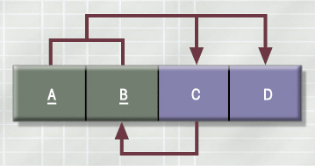
Boyce-Codd Normal Form (BCNF)
Special case of 3NF.
A relation is in BCNF if it’s in 3NF and there is no hidden dependencies.
Below is in 3NF but not in BCNF

Slide 26
BCNF
Don’t confuse with Transitive Dependency!
Stu_ID | Advisor | Major | GPA
123 | Nasa | Physics | 4.0
123 | Elvis | Music | 3.3
456 | King | Literature | 3.2
789 | Jackson | Music | 3.7
678 | Nasa | Physics | 3.5
Advisor (part of determinant) is functionally dependent on Major

Slide 27
Stu_ID | Advisor | Major | GPA
123 | Nasa | Physics | 4.0
123 | Elvis | Music | 3.3
456 | King | Literature | 3.2
789 | Jackson | Music | 3.7
678 | Nasa | Physics | 3.5
What kind of anomaly will happen if the advisor “Nasa” in physics is replaced by “Einstein”?
What kind of anomaly will happen if MIS professor John Doe must be assigned to the new major (MIS)?
What kind of anomaly will happen if the student number 789 withdraw from school so that it must be deleted from the table?

Slide 28
BCNF
Advisor is functionally dependent on Major.
Stu_ID, Advisor → major, GPA
Major → Advisor
Don’t confuse with Transitive Dependency!

Slide 29
Conversion to BCNF
Student
Advisor
FK
Stu_ID | Advisor | GPA
123 | Nasa | 4.0
123 | Elvis | 3.3
456 | King | 3.2
789 | Jackson | 3.7
678 | Nasa | 3.5
Advisor | Major
Nasa | Physics
Elvis | Music
King | Literature
Jackson | Music

Slide 30
3NF and BCNF
In practice, most relation schemas that are in 3NF are also in BCNF (if there is no hidden dependency)
In general, it is best to have relation schemas in BCNF. If that is not possible, 3NF will do
However, 2NF and 1NF are not considered good relation schema designs

Slide 31
Normalization & Database Design
Normalization should be part of the design process
Unnormalized:
Data updates less efficient
Indexing more cumbersome
E-R Diagram provides macro view
Normalization provides micro view of entities
Focuses on characteristics of specific entities
May yield additional entities
Generally, most database designers do not attempt to implement anything higher than Third Normal Form or Boyce-Codd Normal Form

Slide 32
Thank you

